Slide 1
Sales_insight_tableau
File created on: 03-01-2025 14:55:40

Slide 2
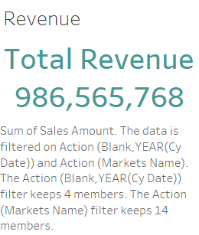

Slide 3
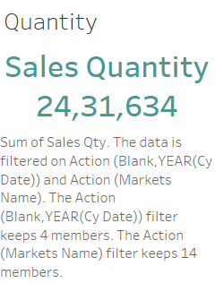

Slide 4
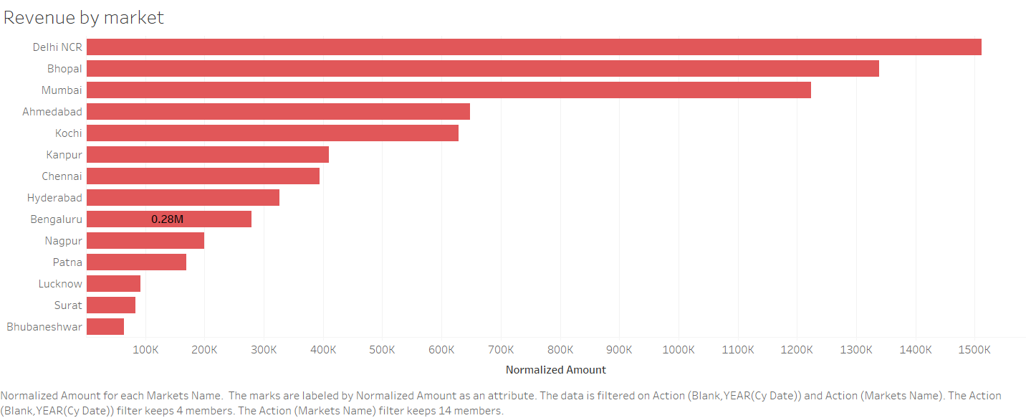

Slide 5
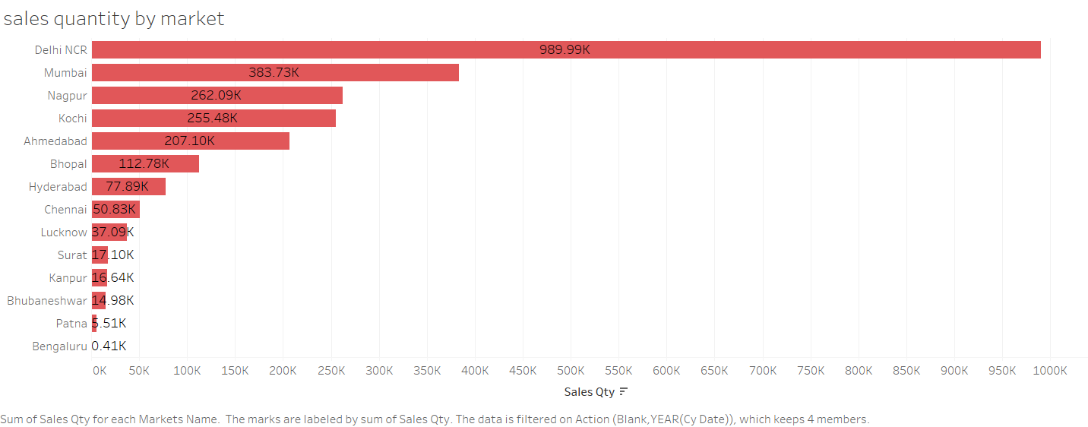

Slide 6


Slide 7


Slide 8
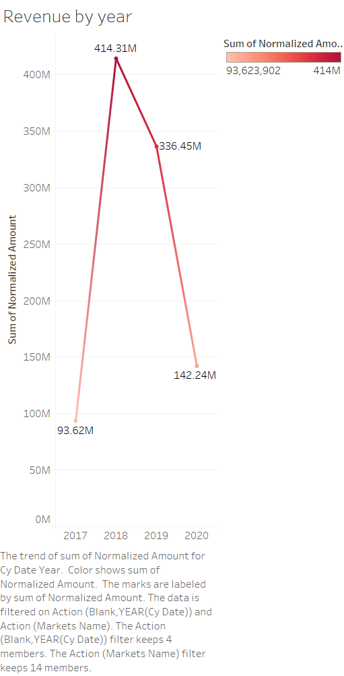

Slide 9
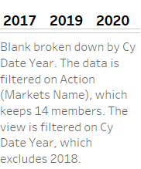

Slide 10


Slide 11
